Slide 1



SMART INDIA HACKATHON 2025
KRISHIBODH
•Problem Statement ID –SIH25062
•Problem Statement Title-
Implementation of Smart Agriculture for Efficient
Cultivation in Hilly Regions, GOVT Of SIKKIM
•Theme- Agriculture , FoodTech and Rural Development
•PS Category- Hardware
•Team ID- 12
•Team Name: ABHIMANYU

Slide 2

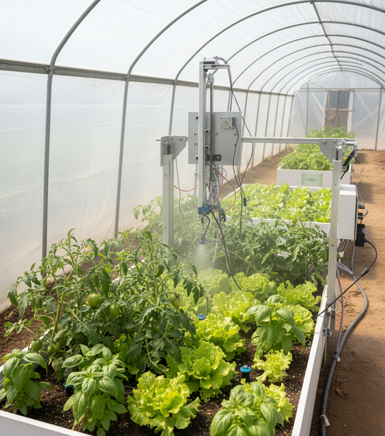
KRISHIBODH
Abhimanyu
Proposed Solution
CNC-powered automation system for polyhouse farming
Executes seeding, watering, and monitoring with zero guesswork
Sensor-based precision irrigation via microcontroller logic
Built for enclosed environments to neutralize climate uncertainty
@SIH Idea submission- Template
2

Slide 3

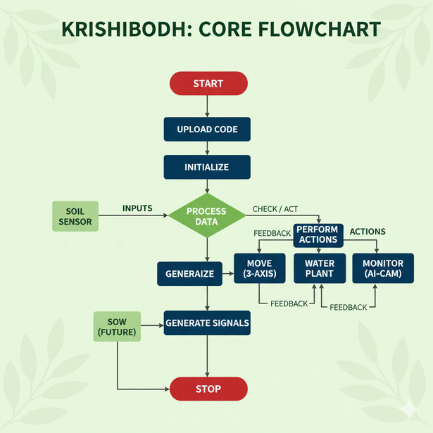
TECHNICAL APPROACH
Abhimanyu
Technologies in
KRISHIBODH
Hardware components: Arduino UNO, Raspberry Pi 3, Nema 17 stepper motor, Relay module, Sensors.
Programming Languages: Python(AI/ML), C++(Microcontroller).
Frameworks & Libraries: OpenCV for image processing, Flask (Backend).
Future Enhancements: AI driven- image processing, User interface integration
@SIH Idea submission- Template
3

Slide 4


FEASIBILITY AND VIABILITY
Abhimanyu
CHALLENGES
SOLUTIONS
Aspect
Viable
Feasible
Soil erosion during heavy monsoon rains washes away fertile topsoil
No erosion – soil is protected from rain; only controlled irrigation is used.
Smart irrigation can be set up
Water
Saves 40–50% water
Water scarcity in summer terraces rely on rain-fed irrigation and stored water.
Efficient irrigation – drip + sensor-based watering saves 40–50% water.
Prevents soil erosion
Polyhouse protects soil
Soil
Can be built with available tech
High labour & maintenance – repairing terrace walls, bunds, and drainage systems regularly.
Low maintenance – modular automation reduces labour and upkeep.
Works with Arduino + IoT + AI
Technical
Low-cost, modular units
Increases yield & income
Economic
Unpredictable rainfall dependency – crop loss if rains fail.
AI + IoT controlled environment – irrigation and climate independent of rainfall.
4

Slide 5

IMPACT AND BENEFITS
Abhimanyu
Social Impact: Krishibodh improves quality of life by saving time and effort, especially for smallholder and women farmers in Jorethang, South Sikkim.
Empowering Innovation: It promotes youth-led, tech-driven agriculture, boosting confidence and aligning with sustainable development goals.
Potential Impact On Sikkim
●
Jorethang & Low-Altitude South Sikkim:
●
Hilly Terrain:
●
Rainfall Pattern:
Economic Impact: Saves 40–50% water, reducing input costs and supporting sustainable farming during dry seasons.
Boosts Incomes: Increases yields of cash crops like cardamom, ginger, oranges, tea, and vegetables, raising farmer incomes and reducing climate-related losses.
Strengthens Exports: Enhances the “Sikkim Organic” brand, creating opportunities for premium global exports and more reliable farming systems.
●
Greenhouse Suitability:
Environmental Impact:
●
Promotes
Water Conservation through rainwater
harvesting and precision irrigation.
While KRISHIBODH focuses on precision irrigation and crop monitoring, AIF also improves storage, supply chains, and market access, boosting farmer incomes.
Farmers can combine better yields from KRISHIBODH with reduced post harvestlosses for economic benefit.
●
Reduces soil erosion and runoff in terraced fields, protecting fragile Himalayan ecology.
●
Encourages climate-smart agriculture, helping Sikkim adapt to rainfall variability and rising temperatures.
5

Slide 6
RESEARCH AND REFERENCES
Abhimanyu
Krishibodh uses CNC-like precision with a 3-axis gantry system to move tools (like water nozzles or sensors) accurately across the growing area.
1. High Investment Challenge
Building a polyhouse is expensive, costing around ₹38.80 lakh per acre, which is a significant barrier for most farmers.
2. Government & Bank Support
The NHB provides a 50% subsidy that, when combined with a bank loan, drastically reduces the farmer's debt burden.
3. Technology Drives Profit
Automated farming systems, like "Krishibodh," boost yields by 3-10 times and ensure superior crop quality, making the investment worthwhile.
4. Fast Loan Repayment
High profits from high-value crops allow the farmer to repay the remaining loan in less than one year, achieving financial sustainability quickly.
5. National Cultivation Scale
Across India, approximately 2 lakh hectares (about 494,210 acres) of land are dedicated to protected cultivation, including polyhouses.
6. Karnataka's Leadership in Production
Karnataka is a leader in the polyhouse sector, producing 1.25 million tonnes of fruits and vegetables annually from this farming method.
7. Bengaluru's Subsidy Success
Bengaluru Urban is the biggest beneficiary of the NHB subsidy scheme, successfully utilizing the ~50% subsidy for polyhouse installations.
@SIH Idea submission- Template
6

